Slide 1
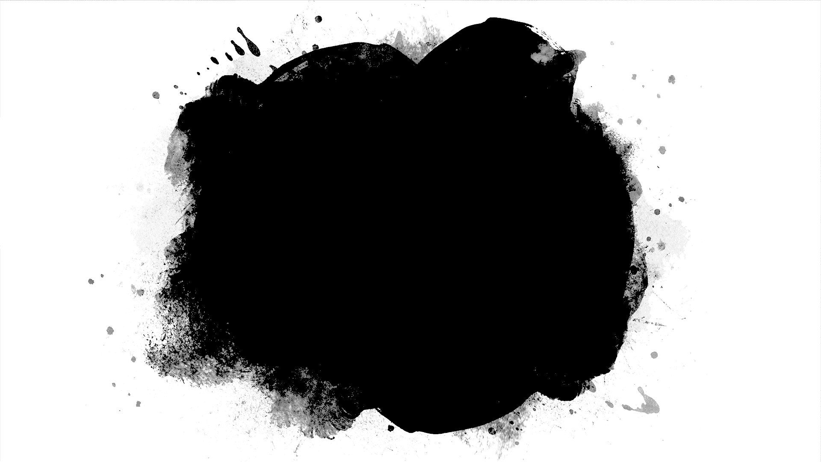
AutoCorrelation

Slide 2
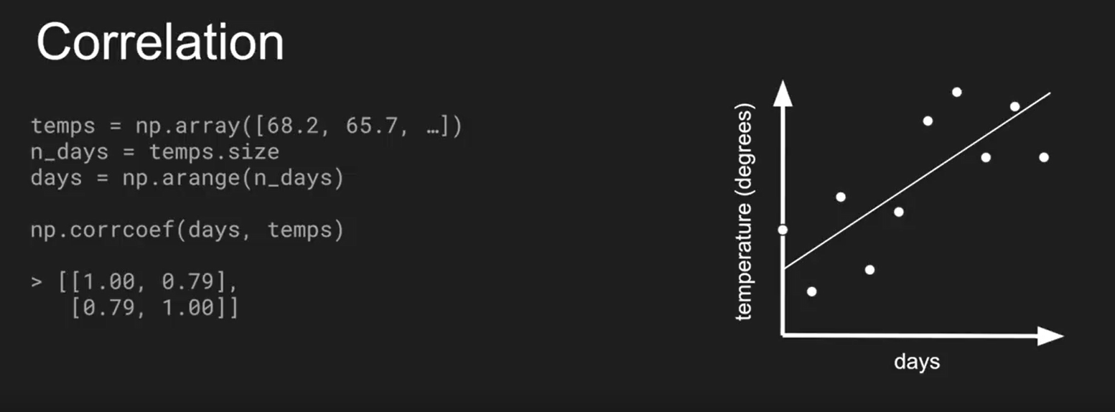
Autocorrelation
(Following is a simple correlation between temperate and days)

Slide 3
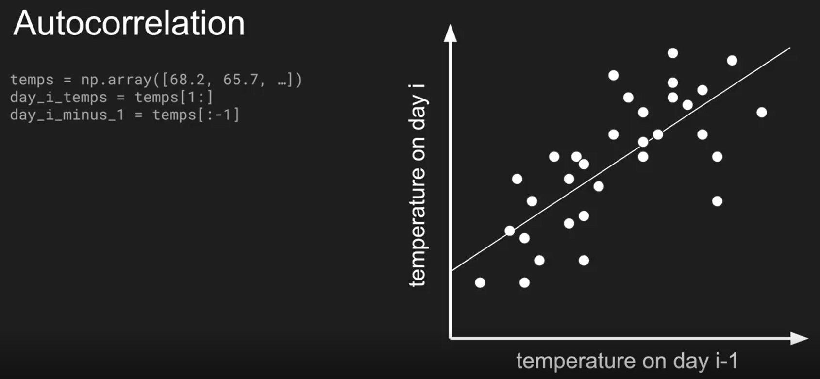
Autocorrelation
We will try to correlate Temperature with itself
(Since temperate is time-series, this correlation of shifting the time 1 step is autocorrelation)

Slide 4
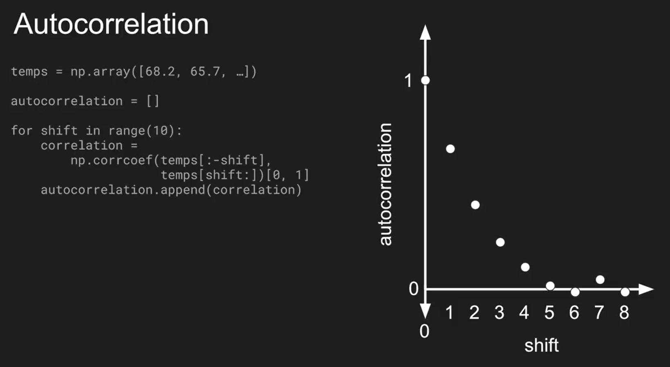

Slide 5
RNN Simple Example

Slide 6
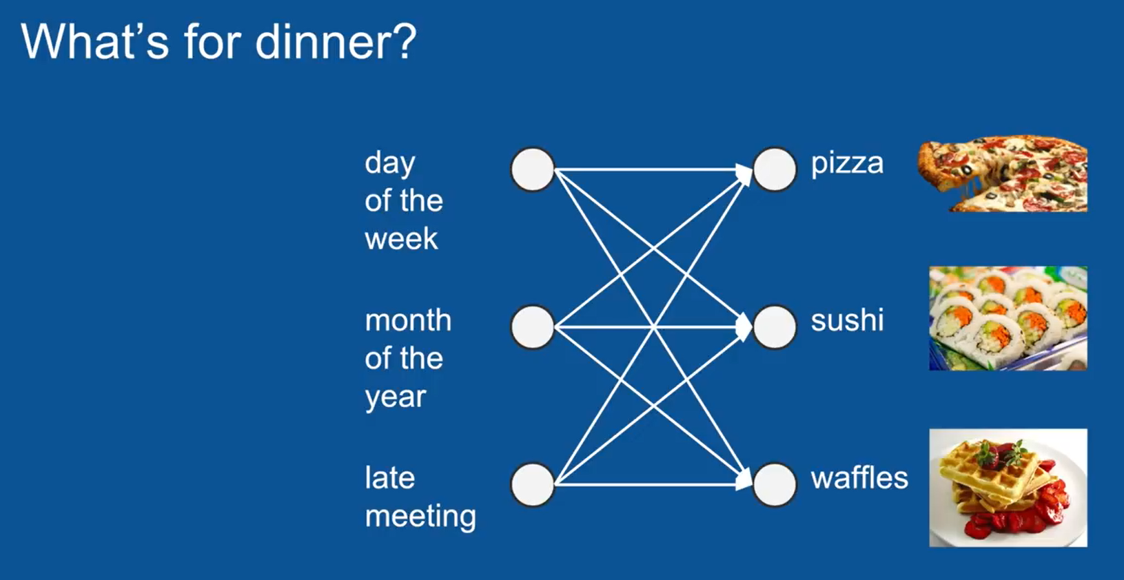
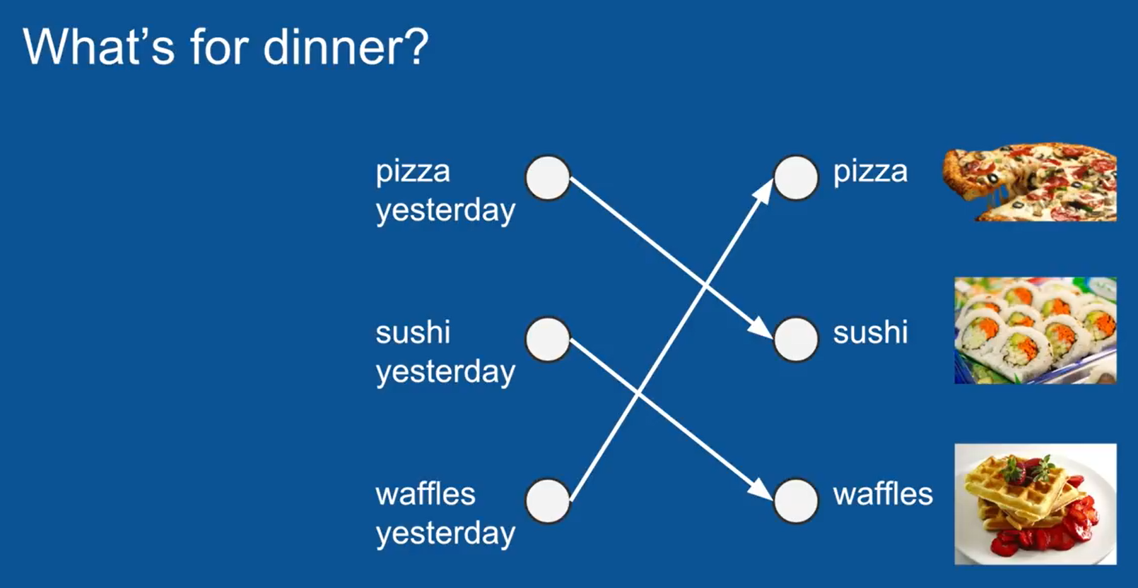
RNN Example

Slide 7
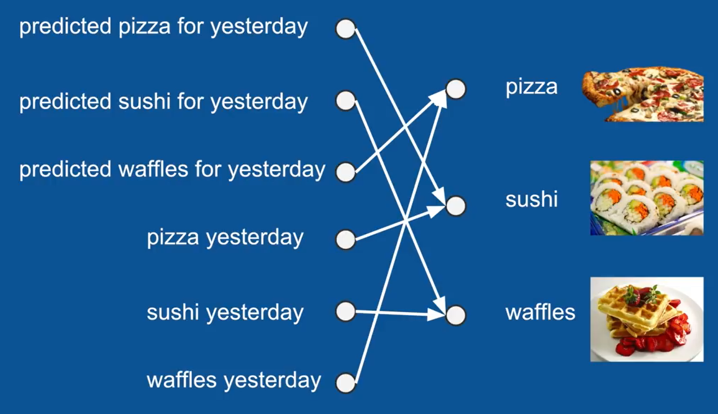
RNN Example

Slide 8
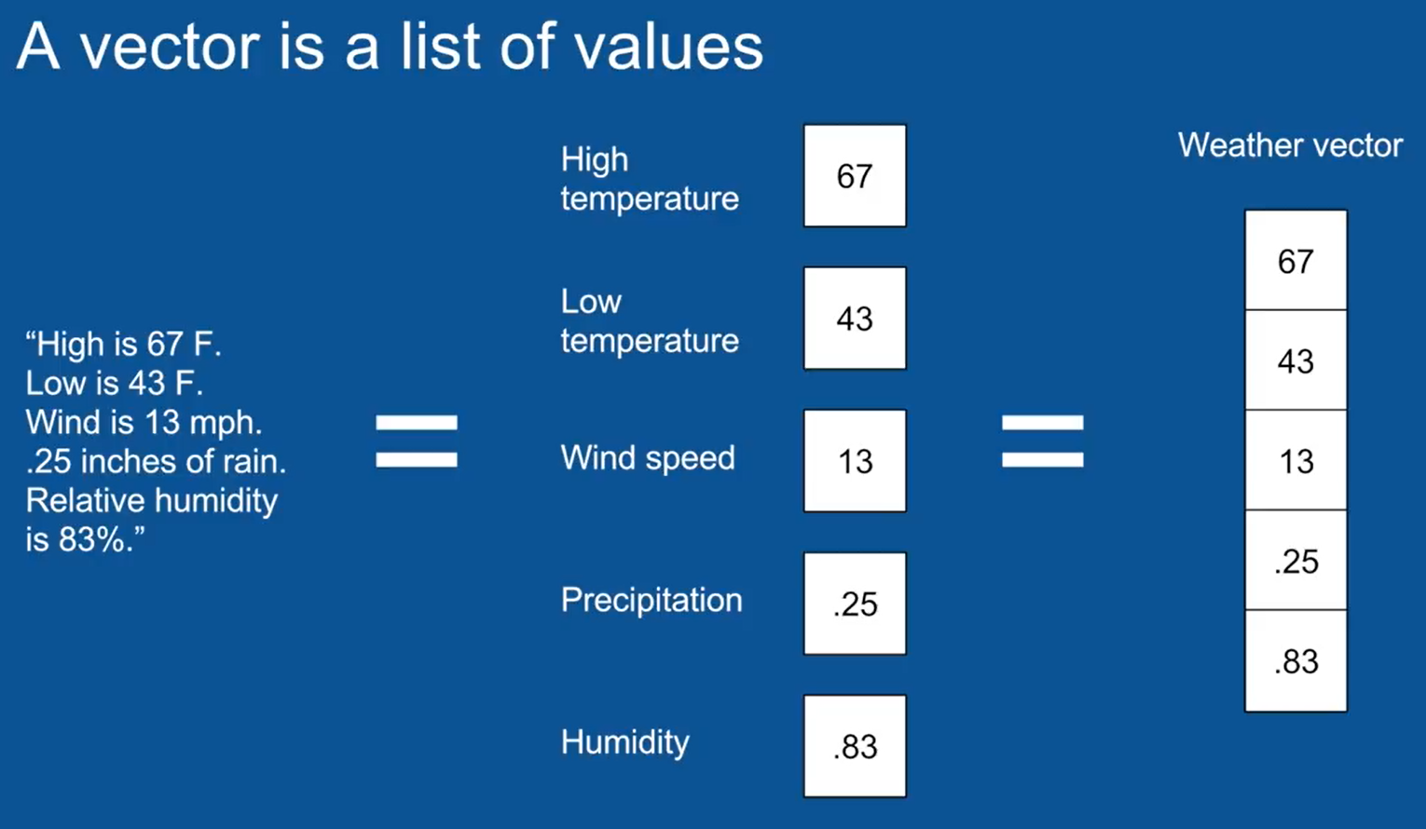
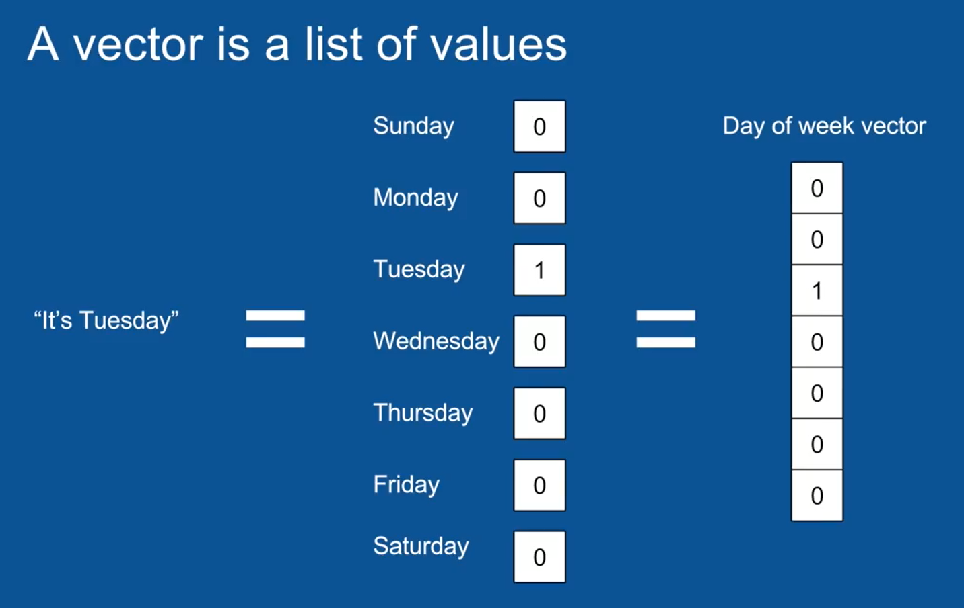
Revisiting Vectors and One-Hot Encoding

Slide 9
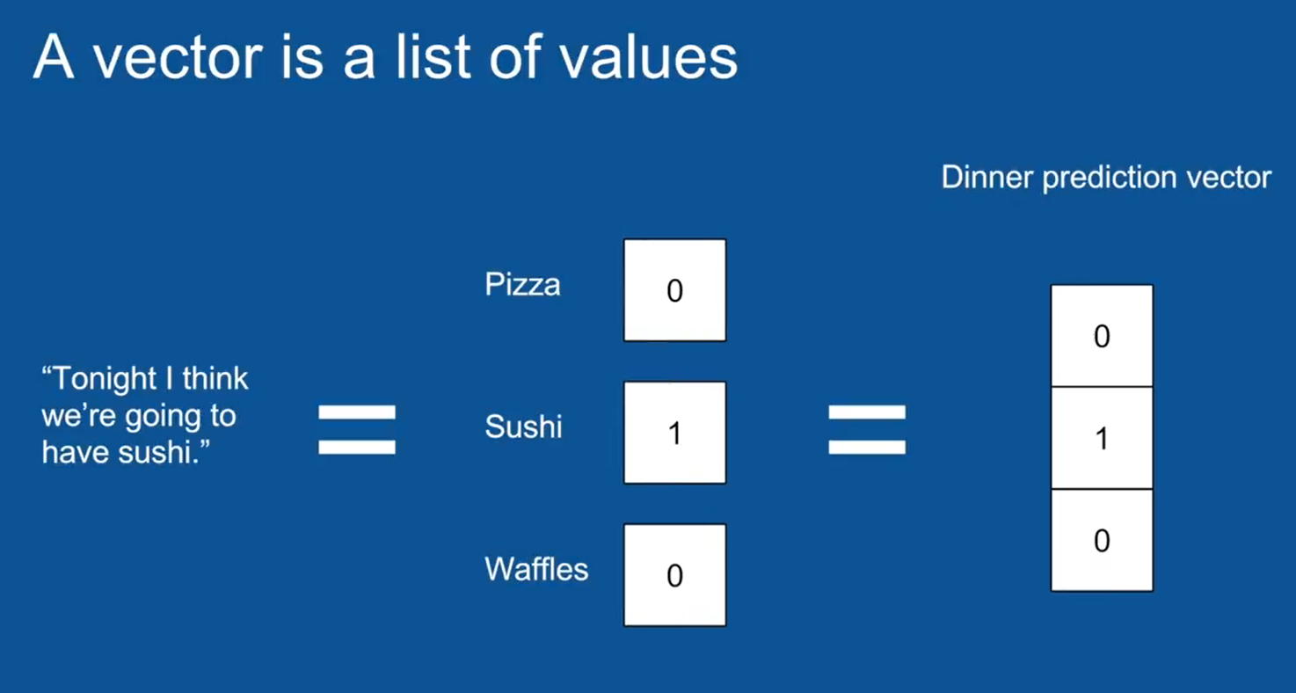
RNN Example

Slide 10
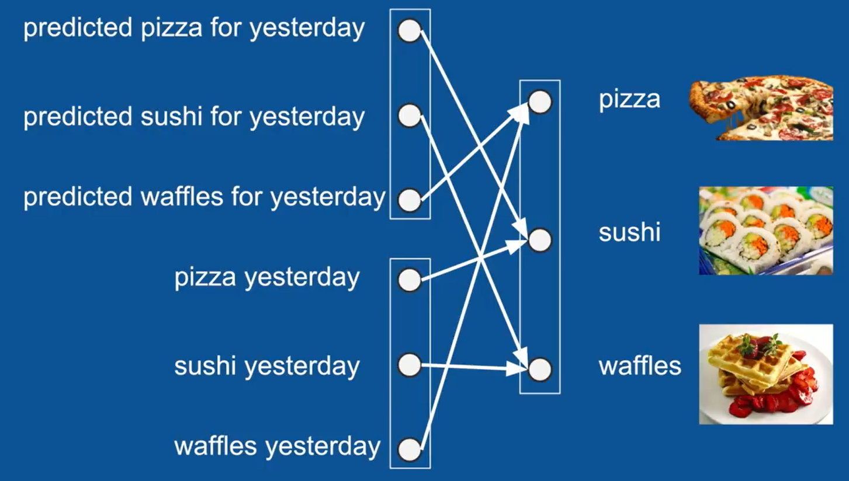
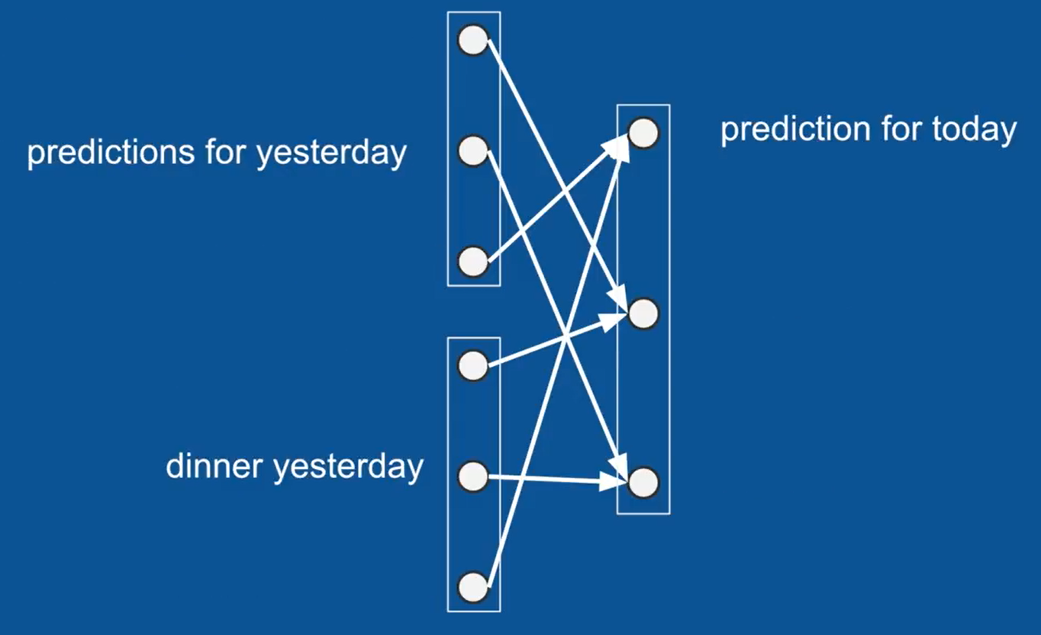
Grouping together inputs and outputs to vectors

Slide 11
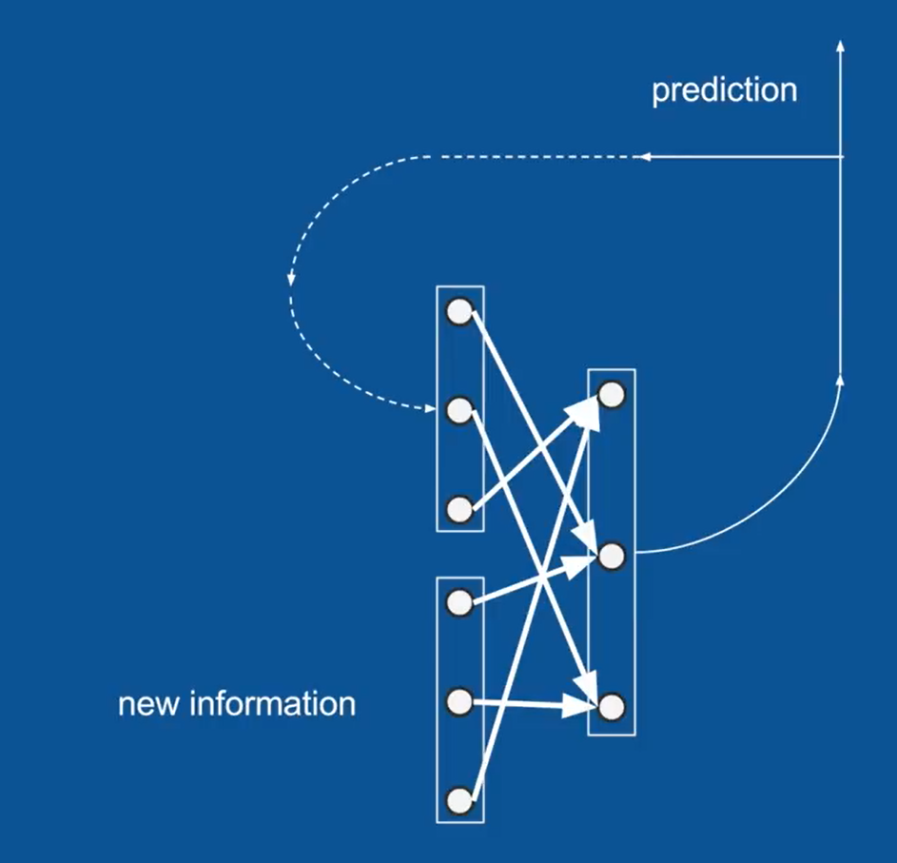
How Prediction for today gets recycled

Slide 12
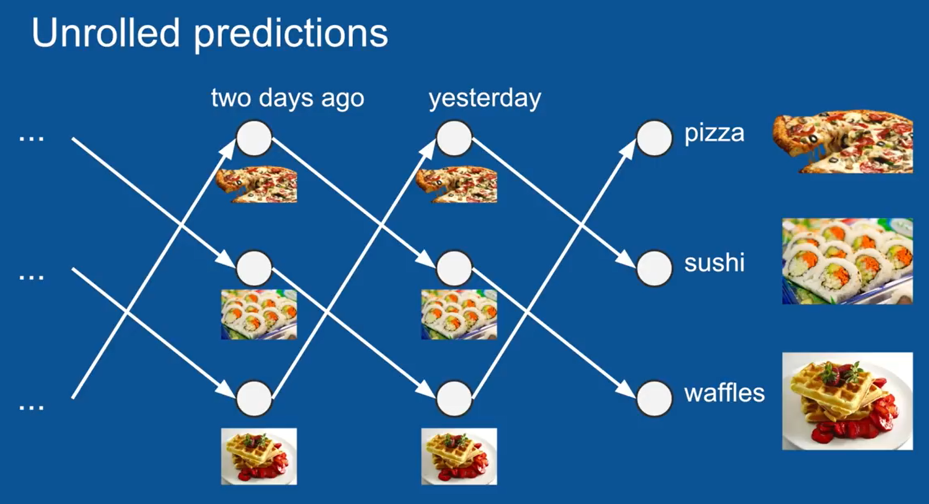
Unrolled Predictions

Slide 13
RNN for Text Simple Example

Slide 14
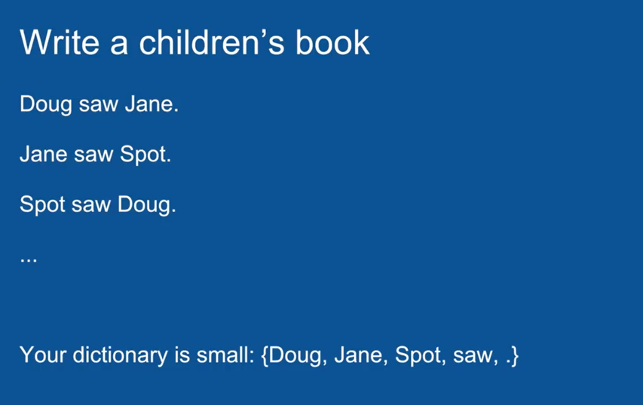
Children’s Book

Slide 15
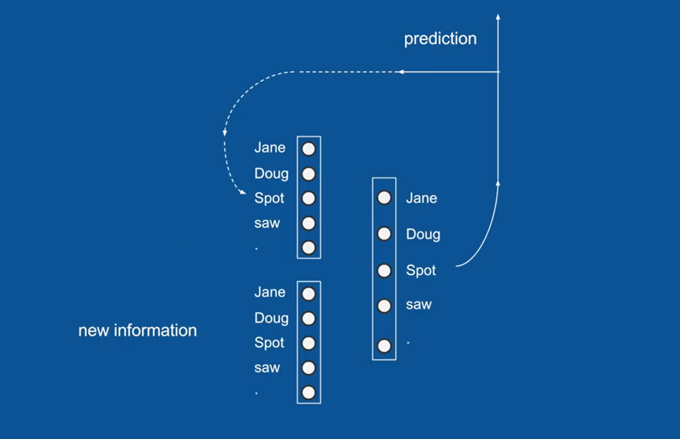
Task of RNN –
Put these together in the Right Order to make a Children’s Book

Slide 16
Replaced Our Food Vectors with Our Dictionary Vectors

Slide 17
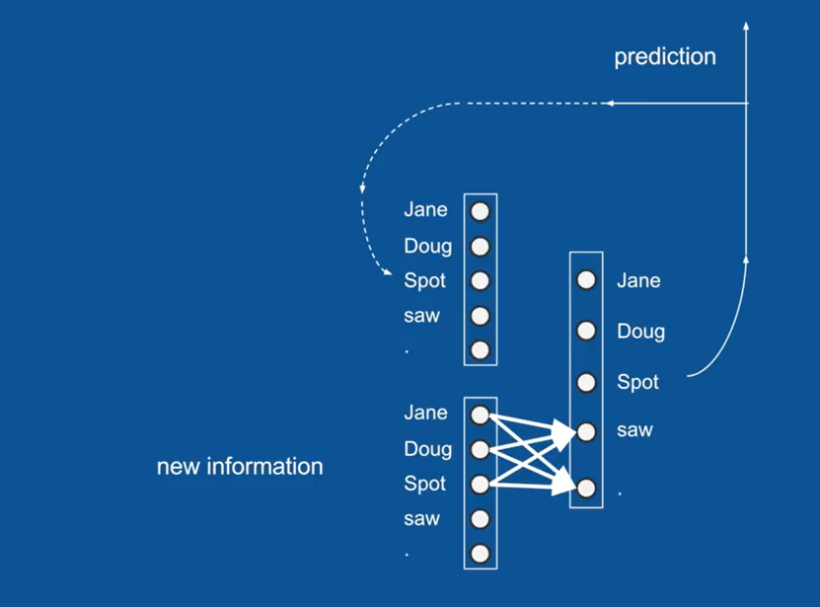
Here again, it’s a list of numbers representing each of the words
If Doug was the most recent word that I saw,
My New Information Vector would be all “0” except for “1” in Doug Position;
We can Similarly Represent our Predictions and Our Predictions from Yesterday;

Slide 18
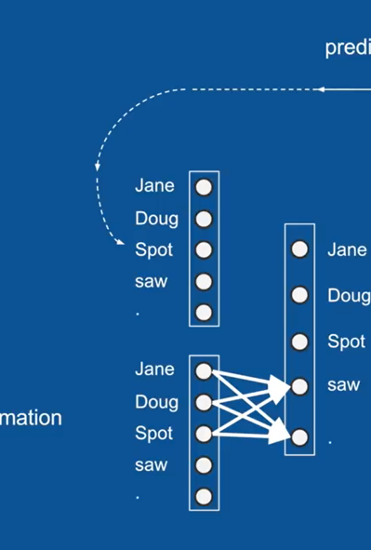
After Training our Neural Network (Teaching it What to do), We would Expect to see some Patterns;
For Instance, Any time a name comes up – Jane, Doug (or) Spot,
We would expect to Vote heavily, for the word “Saw” (or) “,”
Because those are the 2 Words in our Dictionary that can follow a name;

Slide 19
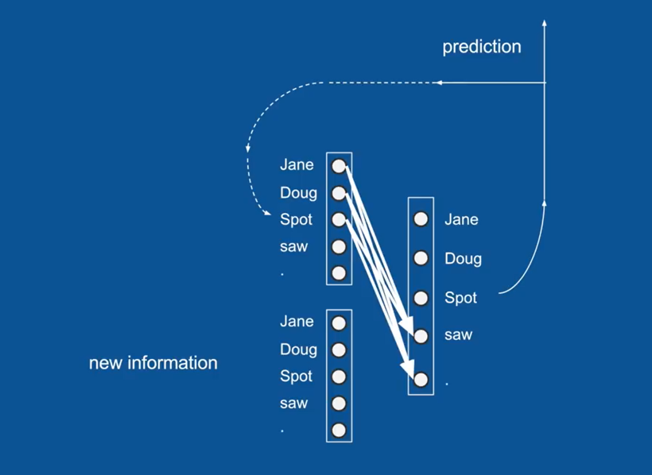
Similarly if, We had predicted a name, in the previous time step,
We would expect those to vote also for the words “saw” or “.”

Slide 20
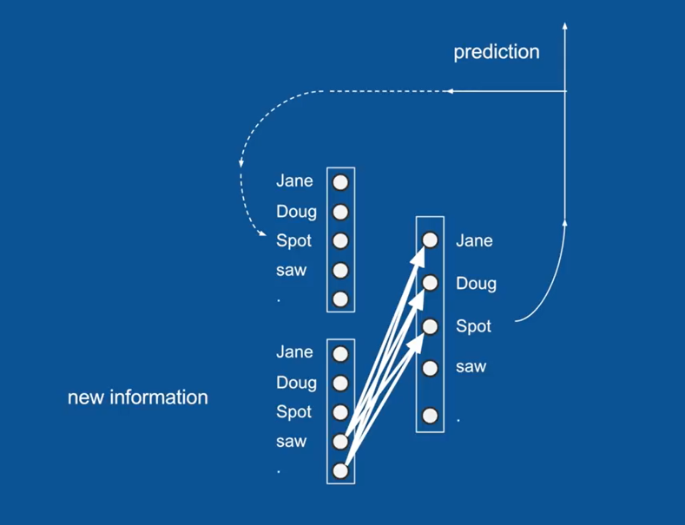
Then, By a Similar Method, Any time, we come across the word “Saw” (or) “.”,
We know that a “Name” has to come after that;
So it will learn to vote very strongly for a “name” – Jane, Doug or Spot

Slide 21
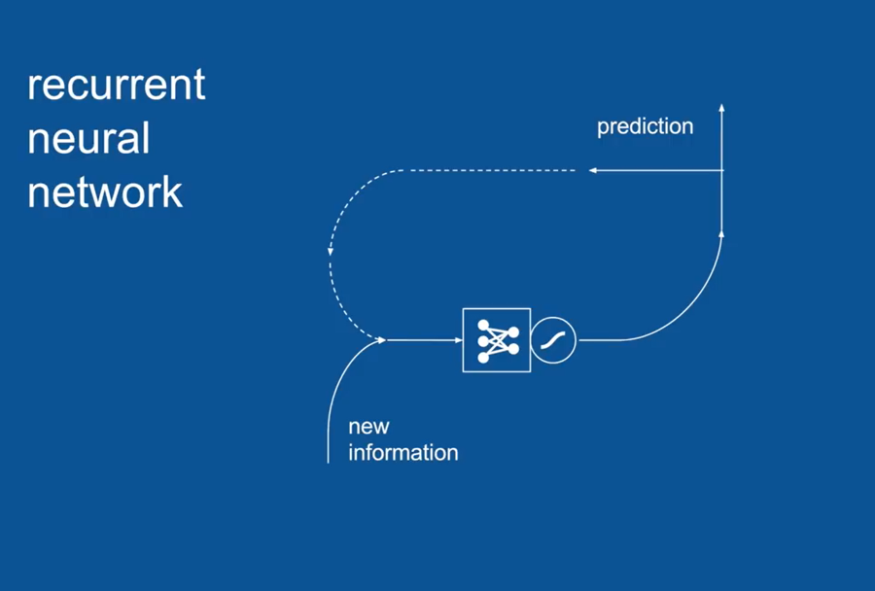
So in this formulation, we have a RNN.
For Simplicity, we will take the Vectors and Weights and Collapse them into Symbol for NN
We also have the “Squashing Function” – Sigmoid or Tanh that tells the network how to behave;

Slide 22
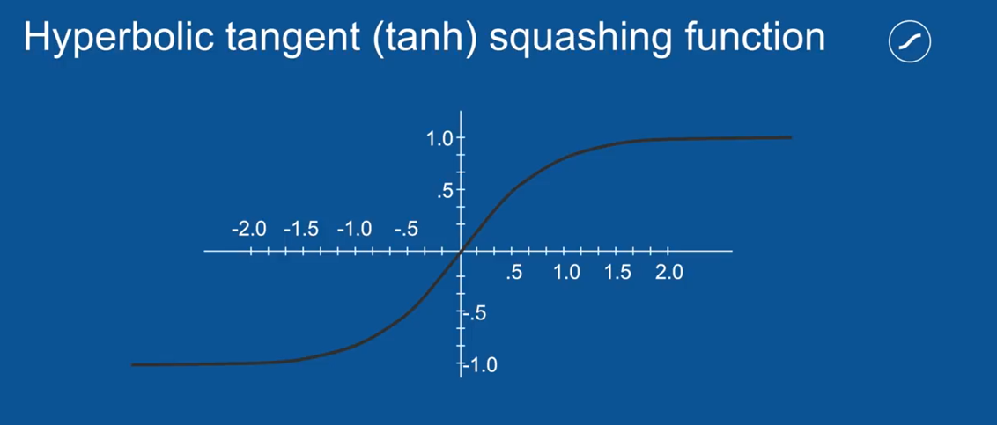
The way the Squashing Function works is –
You take all of your Votes coming out and You subject them to this Squashing Function

Slide 23
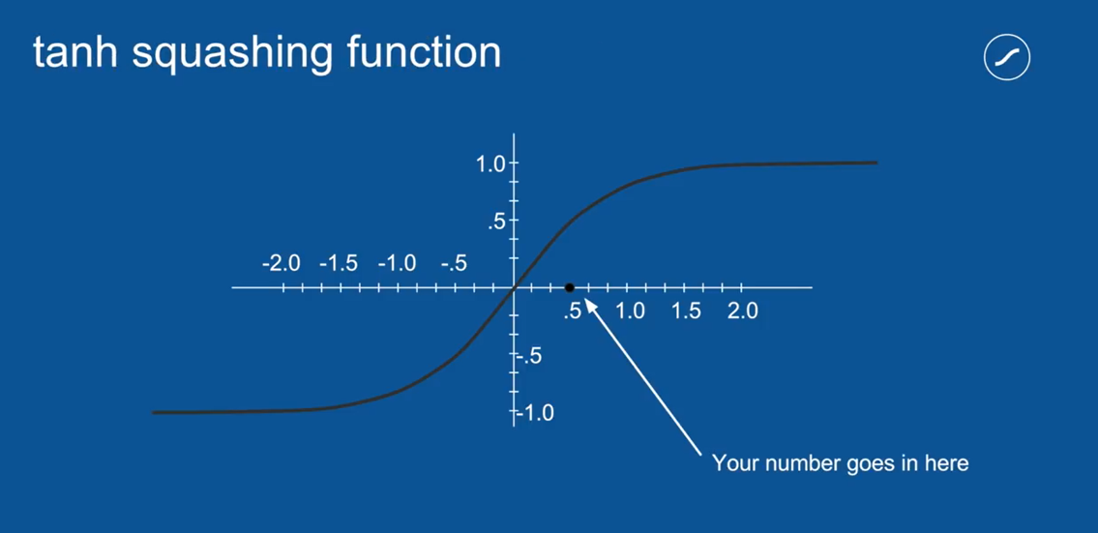
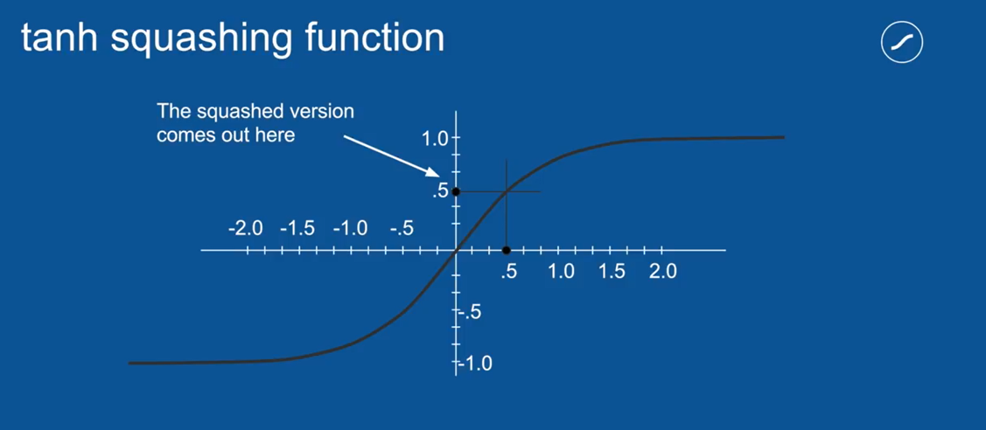
For Instance, if something received a Total Vote of 0.5, you get the Squashed Version as below:

Slide 24
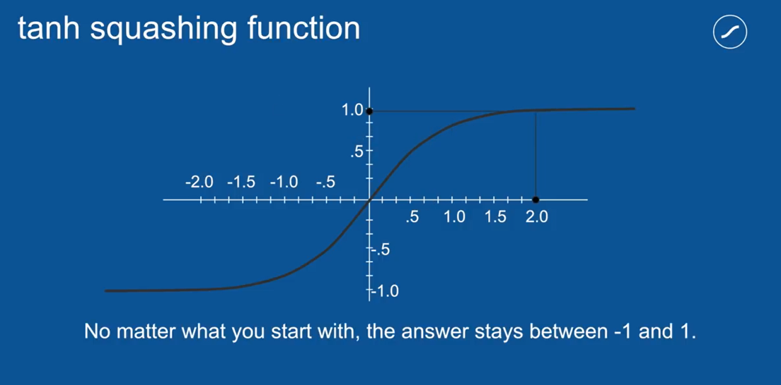
For small numbers this squash version is pretty close to the original version,
But as your number gets larger, the number that comes out is closer and closer to “1”;
Similarly, if you put in a big negative number , what you will get out is very close to “-1”;

Slide 25
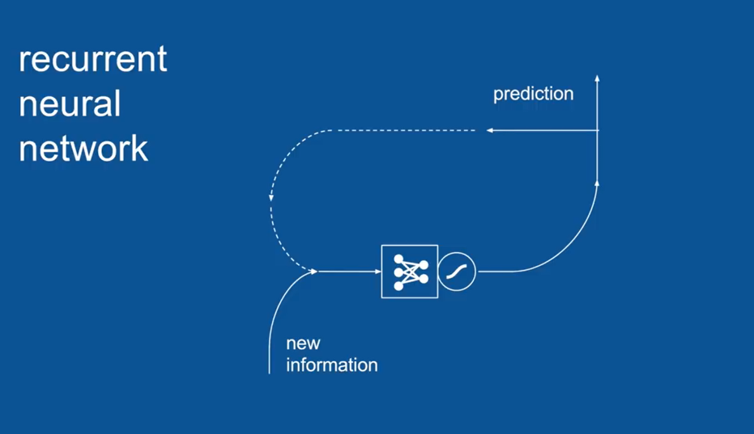
So this is really helpful, when we have a loop like this,
Where the same values gets processed again and again, day after day;
It is possible, you can imagine if in the course of processing say something got voted for “twice” (multiplied by 2), in that case, it would get “twice as big every time”;
And very soon blow up to be astronomical;
By ensuring that it is always < 1 , but > -1, you can multiply it as many times as you want, you can go through that loop and it wont explode;
In a feedback loop, this is an example of negative feedback (or) attenuating feedback

Slide 26
So, you may have noticed that our neural network in its current state is subject to some mistakes
We can get some sentence for instance of the form: Doug, Saw, Doug, . ;
Because Doug strongly votes for the word Saw, Which in turn Strongly Votes for a Any Name, which could be Doug;

Slide 27
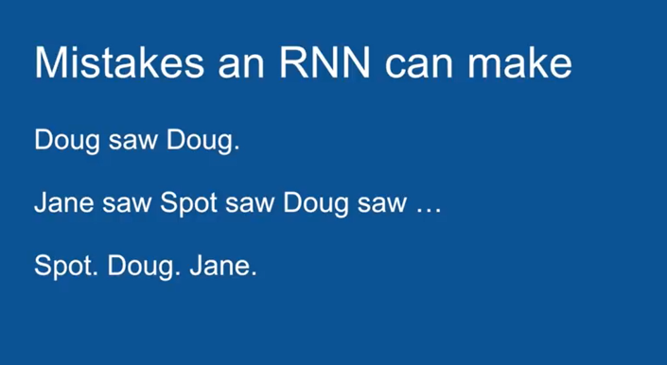
Similarly, We could get something like:
Doug Saw Jane, Saw Spot, Saw Doug
Because Each of our Predictions only: looks back one time step
It has very short term memory

Slide 28
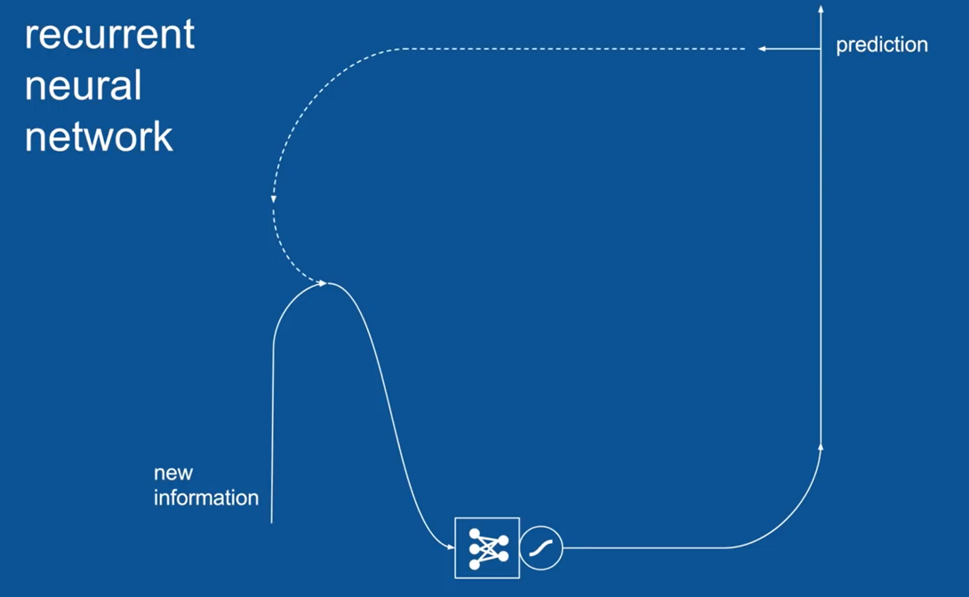
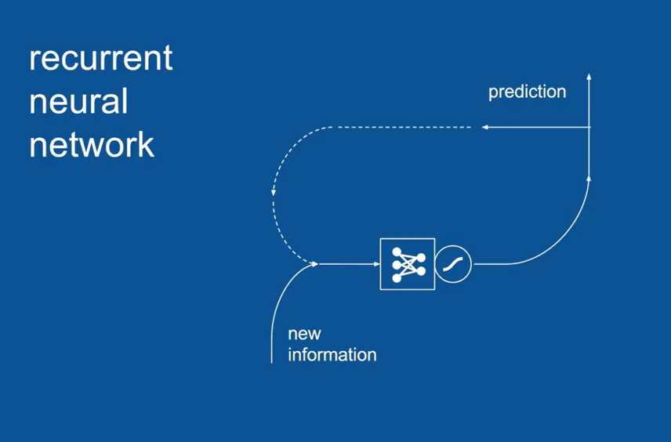
Then it doesn’t use any information from further back;
And it is subject to these types of mistakes
In order to overcome this, we take our RNN and expand it and add more pieces to it

Slide 29
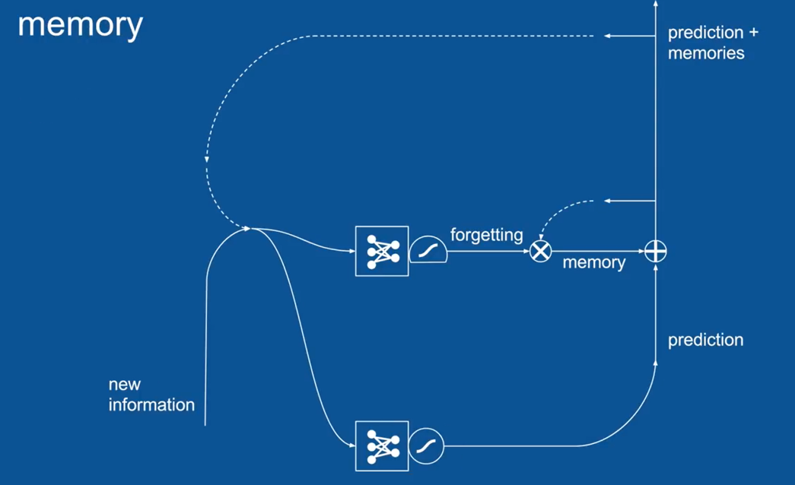
The Critical Part that we add to the middle here is MEMORY;
We want to be able to remember what happened, many timesteps ago;

Slide 30
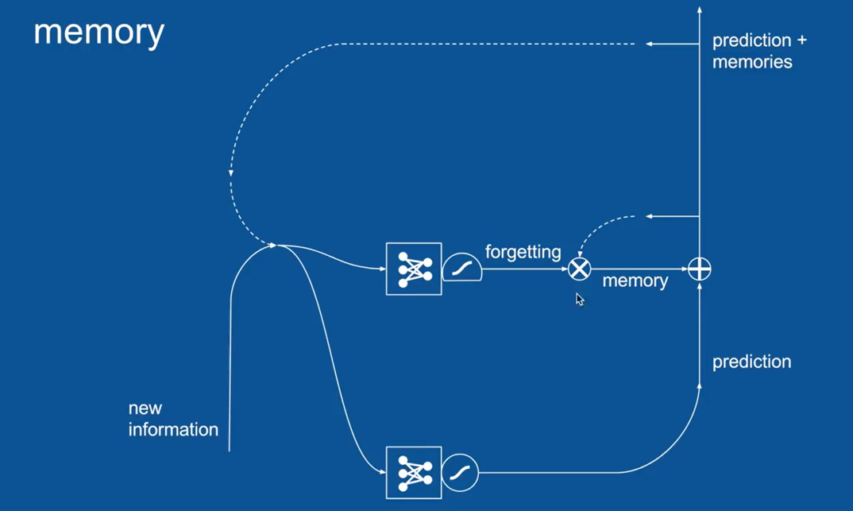
Let Us Explain the “Few New Symbols” Introduced here :
Another Squashing Function with a Flat Bottom;
One “X” in the Circle and
Another “+” in the Circle

Slide 31
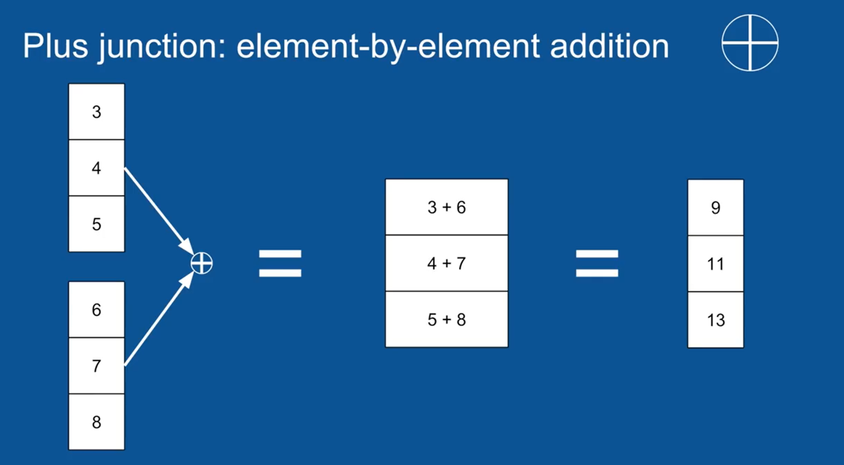

Slide 32
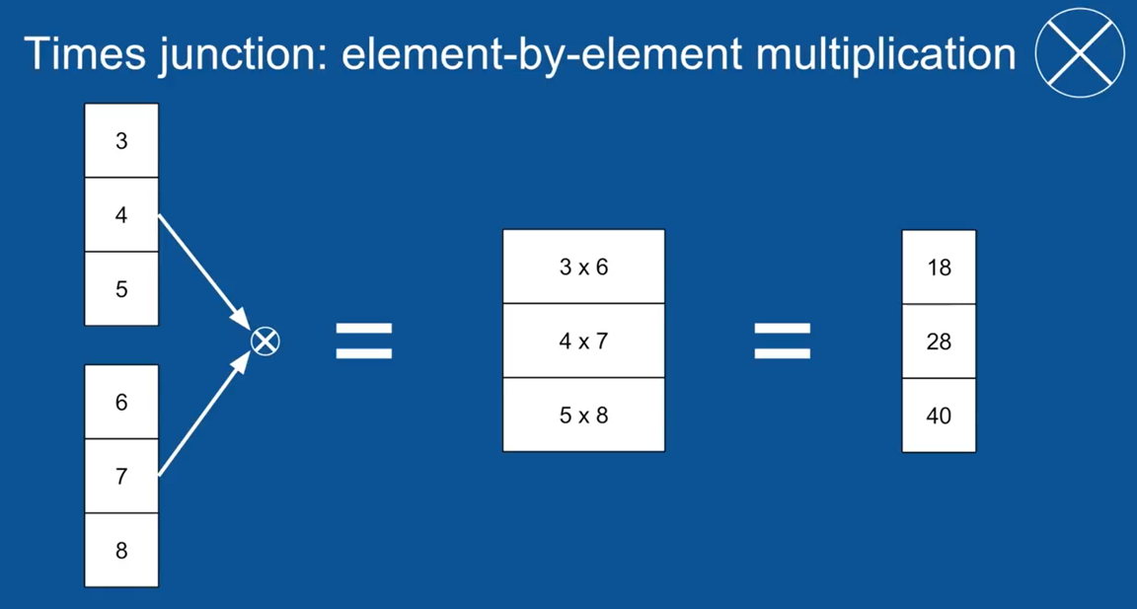

Slide 33
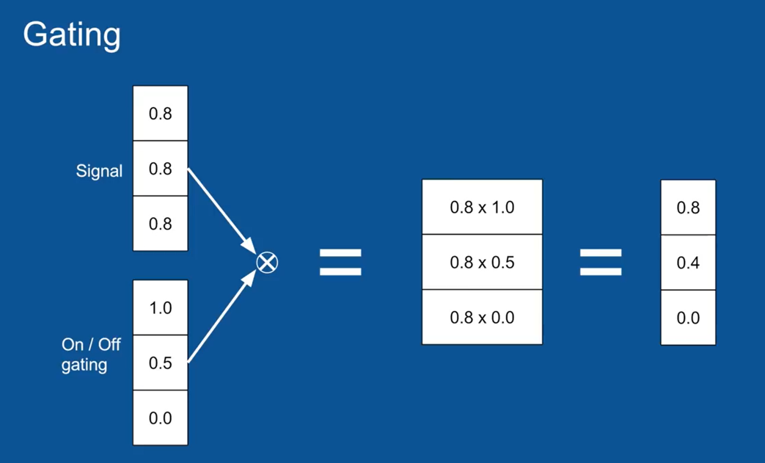
Now, Element-Wise Multiplication lets you do something Pretty Cool
Imagine that you have a Signal, and it is like a Bunch of Pipes
(And they have a certain amount of water trying to flow down them, by assigning a number to them)
Now, On Each of those Pipes, We have a Faucet;
(We Can Open it all the way (or) Close it all the Way (or) (We Can Keep it Somewhere in the Middle)
(To Either Let that Signal Come Through (or) Block it)

Slide 34
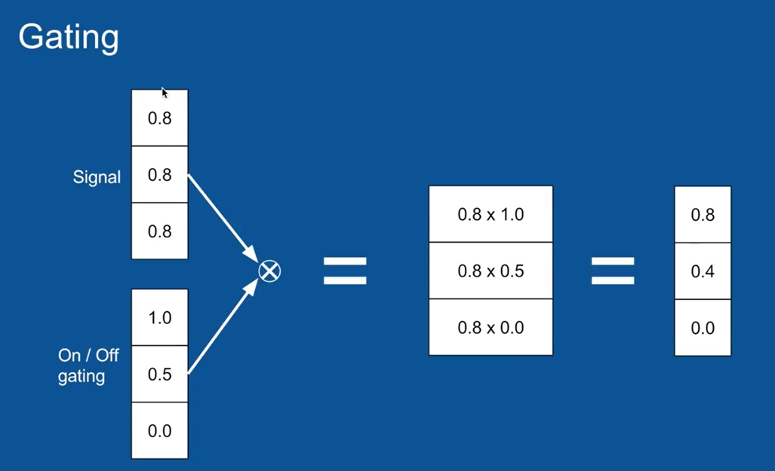
So in this Case:
An Open Gate and An Open Faucet would be a “1”;
A Closed Faucet would be a “0”

Slide 35
The First Element
0.8 x 1.0 = 0.8 ➔ That Signal Passed, Right Through into the Output Vector;
The Last Element
0.8 x 0.0 = 0.0 ➔ That Signal was Effectively Blocked;
Then with the Gating Value of 0.5
0.8 x 0.5 = 0.4 ➔ That Signal was Passed Through, But its Smaller/Attenuated;
So Gating Lets Us Control, What Gets Passed Through and What Gets Blocked

Slide 36
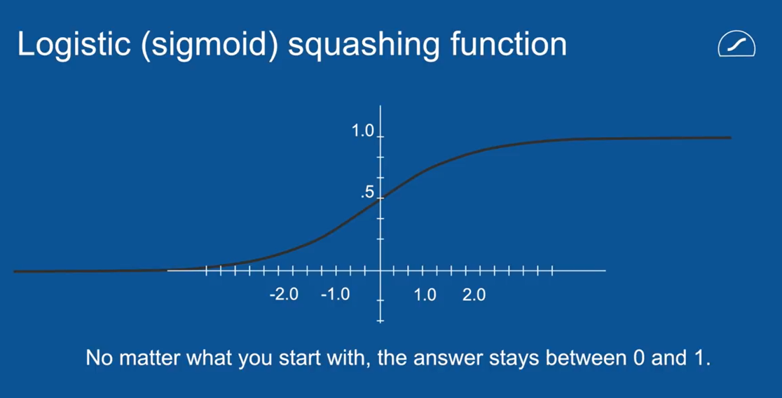
Now, In Order to do Gating ➔ Its nice to have a value that you know, always between 0 and 1
1
So, We Introduced another Squashing Function (Circle With Flat Bottom). It is called Logistic Function
2
(Its very similar to the other Squashing Function, the Hyperbolic Tangent, except it goes between 0-1)
3

Slide 37
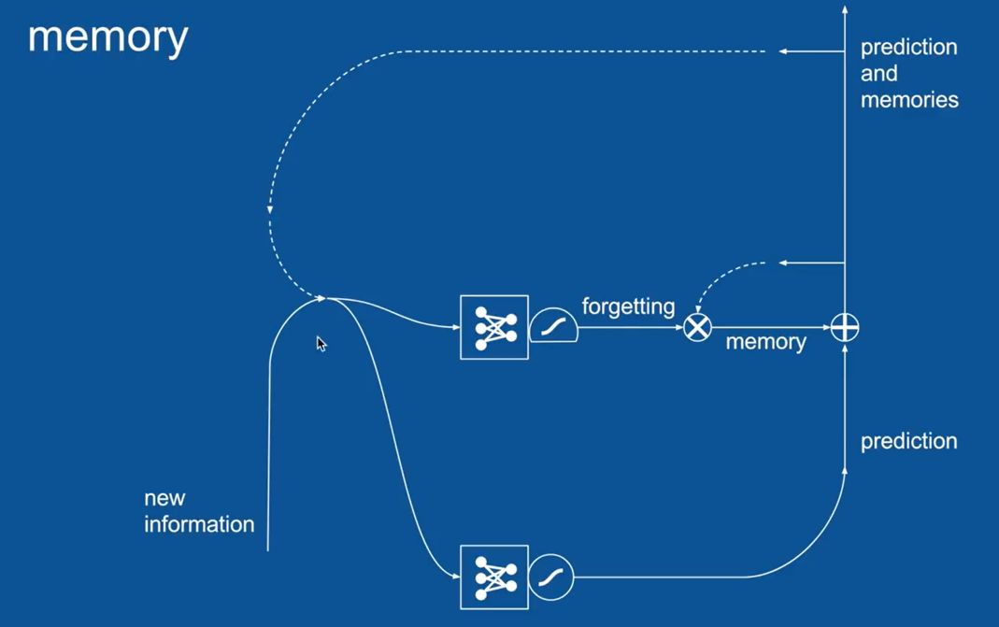
Now, When we Introduce all of these Together
What we get,
Those Vectors gets Passed, And We make Predictions, Based on Them;
We still have the Combination of our Previous Predictions in Our New Information;
When those Predictions gets passed through, The Other thing that happens is that a copy of those Predictions is HELD On to for the Next Time Step when it gets passed through to the network;
Some of them are “Forgotten”, Some of them are “Remembered”.
The Ones that are “Remembered” are “Added back into the Prediction”;
So, Now we have not just “Predictions”, but
Predictions + Memory that we have accumulated and we haven’t chosen to forget yet;
Now, There is an entirely separate “Neural Network” there, that “learns” when to “forget” what;
Based on what we are seeing right now,
What do we want to remember, what do we want to forget;
This is Very Powerful. This let us Hold on to things for as long as we want.

Slide 38
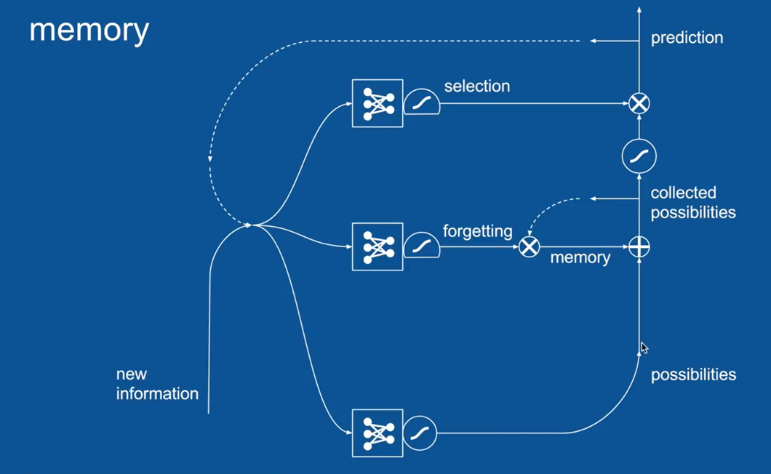
Since we do an “addition” here, it is possible that things could become > 1 or < -1, so we Squash it as below:
We have already introduced another Squashing Function;
We Probably Noticed though, When we are combining:
Our Predictions with Our Memories,
We May NOT want to Release all those Memories Out as New Predictions Each Time;
So, We may want a “Little Filter” to keep our “Memories Inside” and “Let our Predictions get out”;
We Add Another “Gate” Selection for that;
It has its own “Neural Network” and hence Own Voting Process
So that Our “New Information in our Previous Prediction Process” can be used to Vote on :
What all the Gate Should be ?
What Should be kept Internal ?
What Should be Released as a Prediction ?

Slide 39

Each of these things about When to forget
&
When to Let things Out of Our Memory
Are Learned by their Own Neural Networks
Now, When we bring in New Predictions,
We Make a lot of “Possibilities” and “Then We Collect those Memories Overtime”
And of, All those “Possible Predictions”, At Each Time Step,
We Just “Select a Few to Release” as a “Prediction for that Moment”;

Slide 40
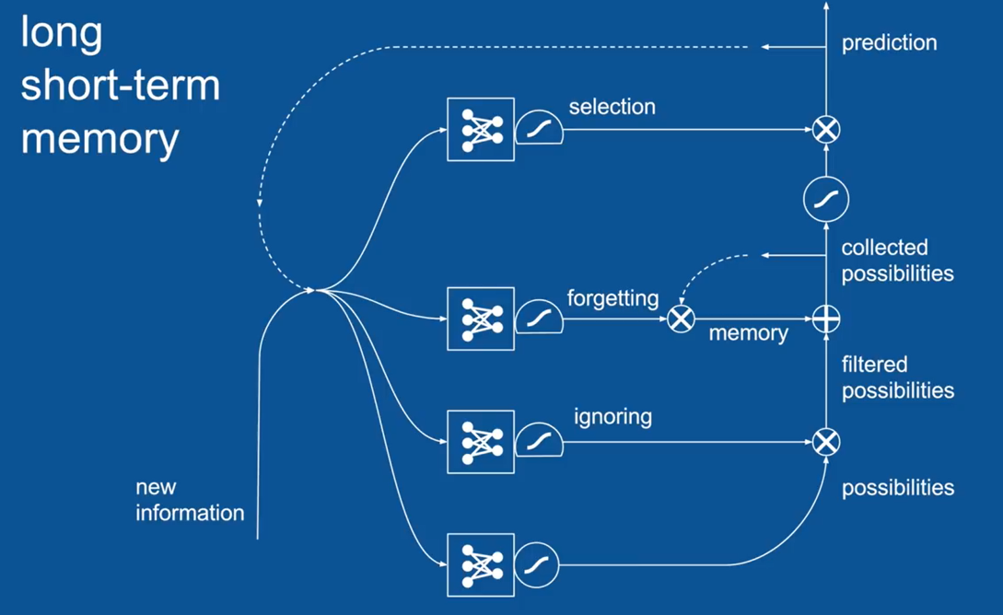

The Only Other Piece that We Need to Add to Complete Our Picture Here is
Yet Another Set of Gates;
This lets us actually Ignore Possible Prediction Possibilities as they come in;
This is an “Attention Mechanism”;
It lets things that aren’t immediately “relevant” to set-aside,
So that they don’t cloud the predictions in memory to keep going forward;
It again has its “Own Neural Network” and its own “Logistics Squashing Function”;
And its “Own Gating Activity”;

Slide 41
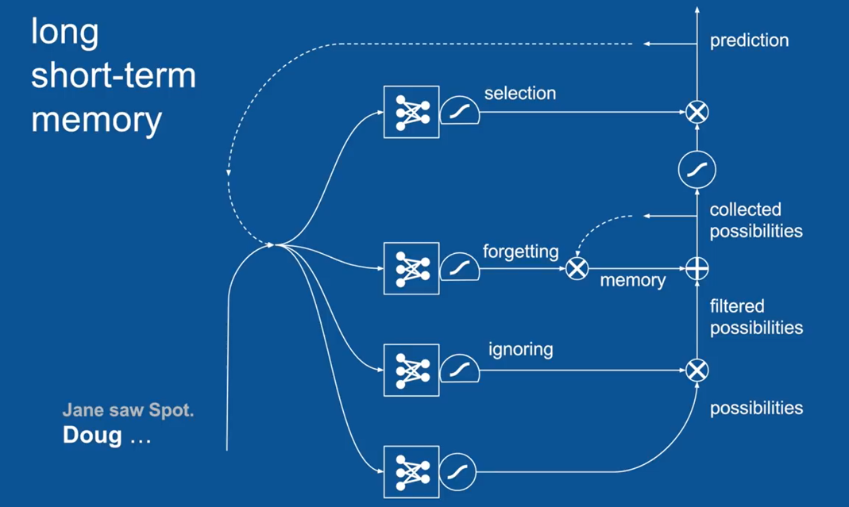
LSTM has lots of pieces, lots of bits that “work together”
And it is very difficult to wrap our head around this all at once;
So we will again take a very simple example and step through it just;
To illustrate how the couple of these pieces work;
Simplistic Example:
We are now in the Process of Writing our Children’s Book;
We will assume that this LSTM has been already trained on our Children’s Book’s Examples that we want to Mimic;
All of the Appropriate Votes and Weights in those Neural Networks have been “learnt” already;
We will show it in action;

Slide 42
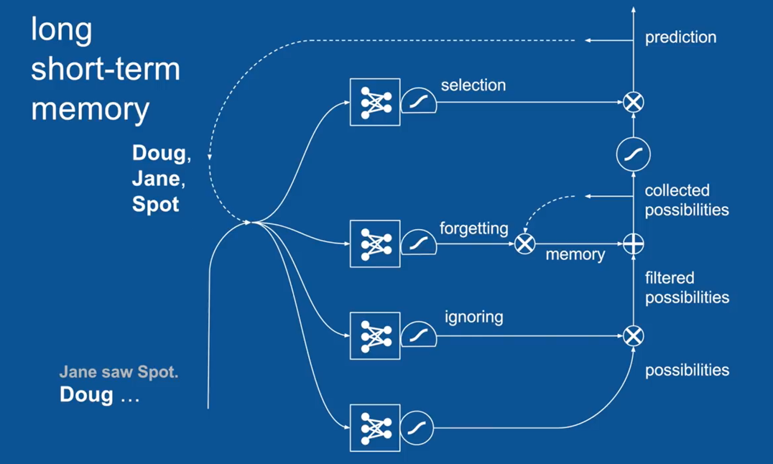
Our Story so far is “Jane saw Spot.”
Doug… is the most recent word that has occurred in our story; And also not surprisingly for this time step,
The Names:
Doug,
Jane,
Spot
Were all Predicted as Viable Options;
This makes Sense, We wrapped up our sentence with a “.”
The New Sentence can start with any names;
Which are all great predictions;

Slide 43
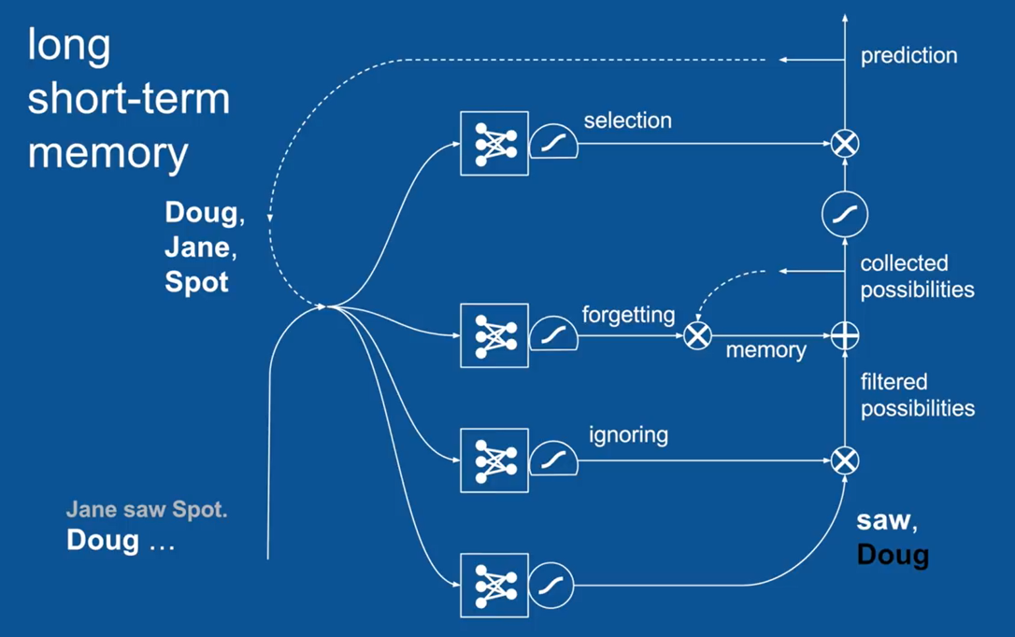
So we have our New Information, Which is the word “Doug”
We have our “Recent Prediction”, which is “Doug, Jane and Spot”;
We Pass these 2 Vectors together to all 4 of our Neural Networks as illustrated , which are Learning to :
- Make Predictions
- To do Ignoring
- To do Forgetting
- To do Selection
The First one of these makes some predictions,
Given that the word Doug, just occurred, This has learnt that the word, “Saw” is a great guess to make for next word;
But it has also learnt that having seen the Word Doug, that it should NOT see the word “Doug again very soon”;
(That is, Seeing the word Doug at the Beginning of the Sentence)
So it makes a Positive Prediction for “saw” and Negative Prediction for “Doug” (It says, I do not expect to see Doug in the near future;)

Slide 44
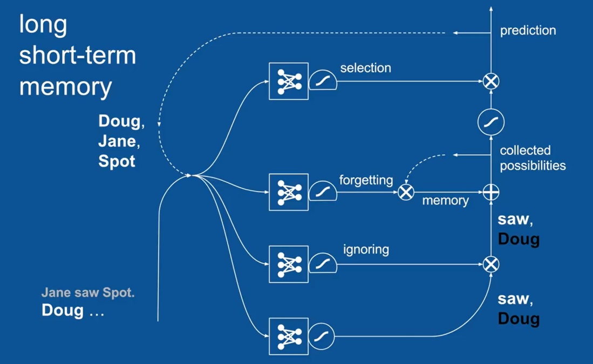
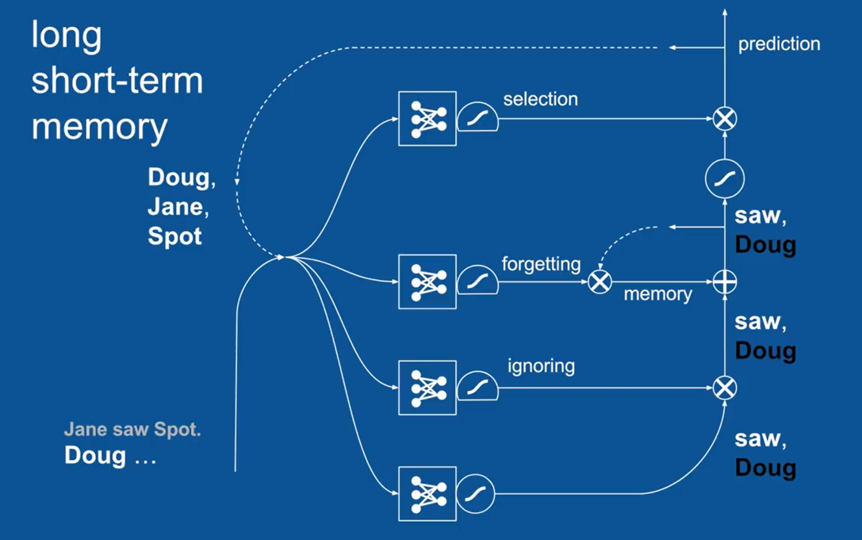
This Example is so simple that we don’t need to focus on attention or ignoring; So we will skip over it for now;
This Prediction of “saw”, and NOT “Doug” is passed forward; (For the purpose of simplicity, let us assume that there is NO memory at present;)
So “saw”, and NOT “Doug” gets passed forward;

Slide 45
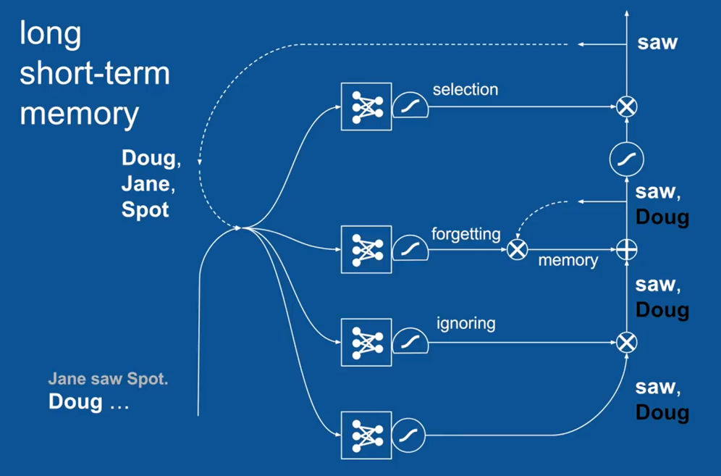
The “Selection” Mechanism, here has learnt , that when the Most Recent was a Name
What comes next is either going to be the word – “saw or .”
So it blocks any other names coming out;
So the fact that there is a vote for “NOT Doug” gets blocked here;
And the word “saw” gets sent out as the Prediction for the Next Time Step;

Slide 46
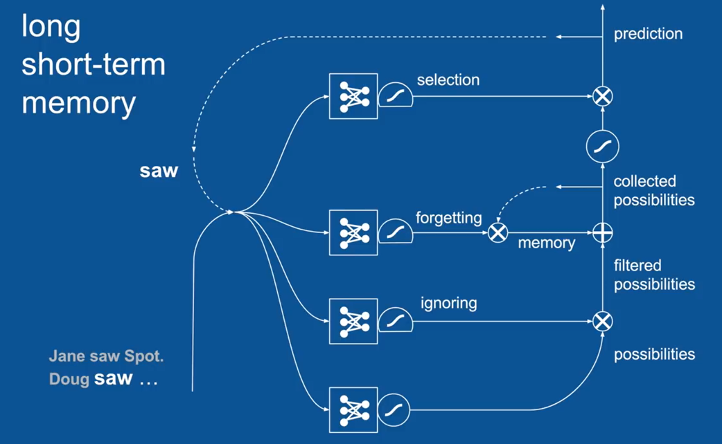
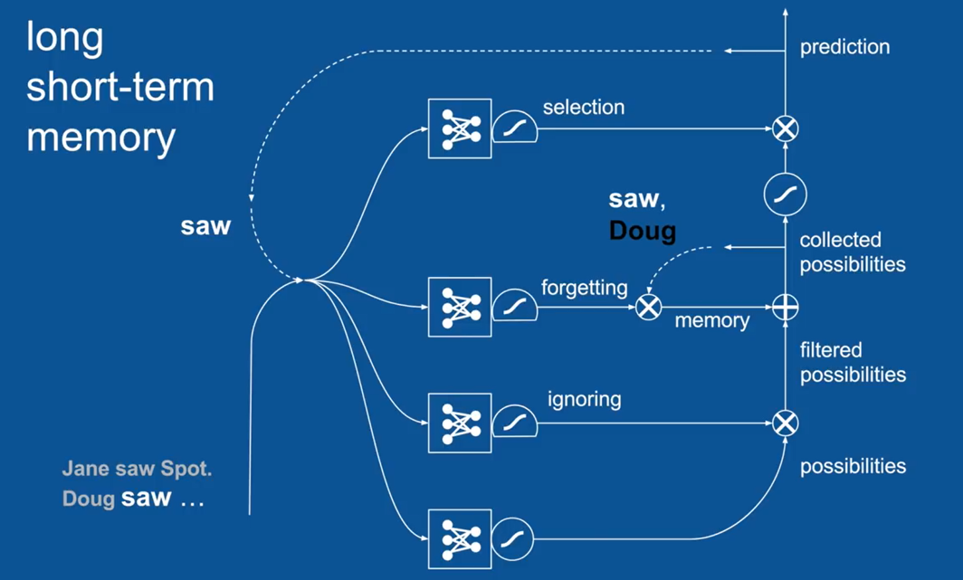
So, we take a step, forward now,
The word “saw” is our most recent word now and most recent prediction,
They get passed over to all these 4 Neural Networks;
And we get a New set of Predictions;
Because the word “saw” just occurred,
We now Predict, that the words, Doug, Jane or Spot might come next;

Slide 47
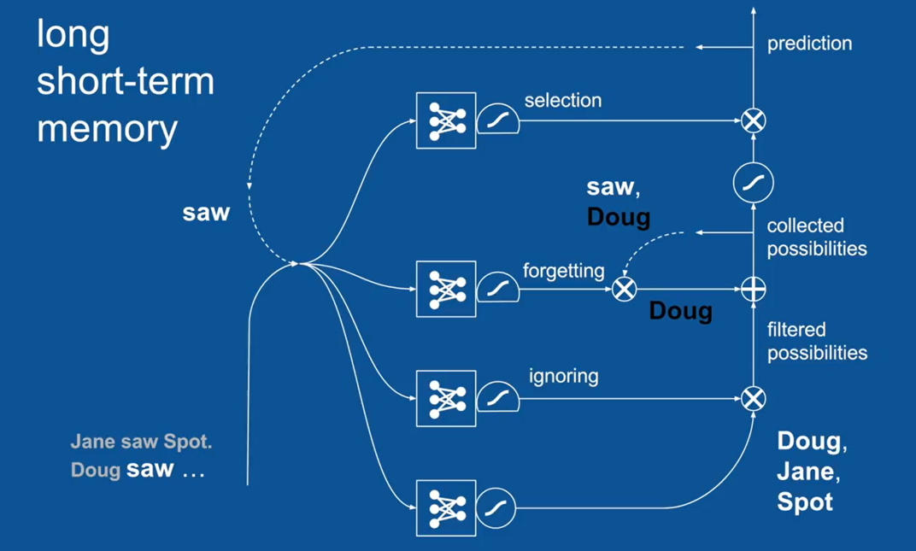
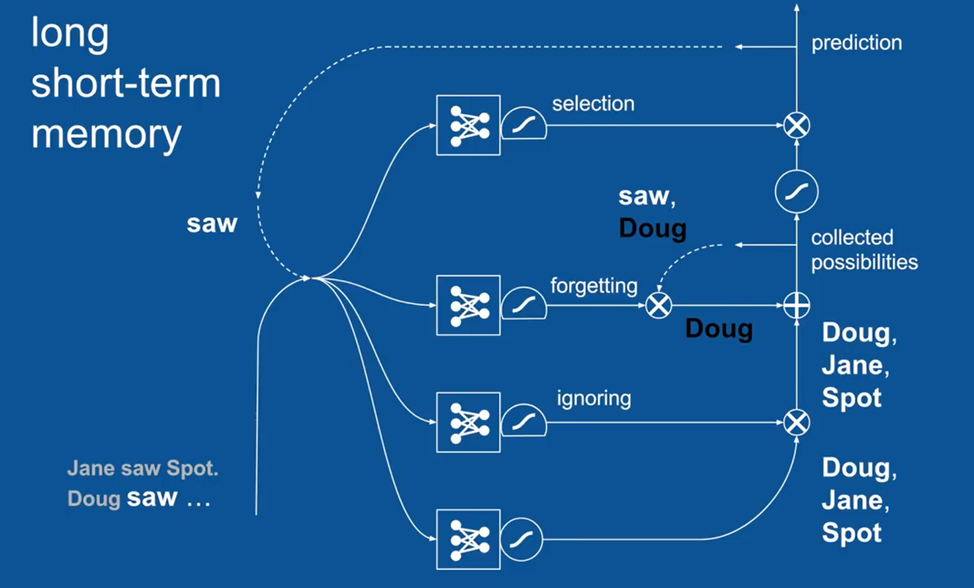
We will pass over, Ignoring and Attention,
And we will take those Predictions Forward

Slide 48
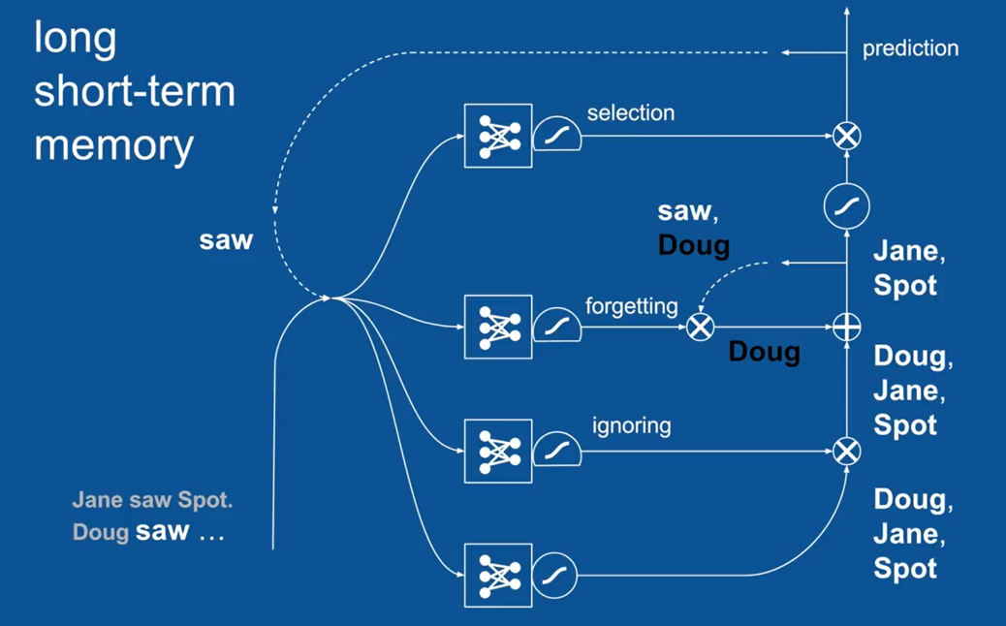
Now the other thing that has happened is our Previous Set of Possibilities
The word “saw” and “NOT Doug”, that we were Maintaining Internally gets passed to our “Forgetting Gate”
Now the Forgetting Gate Says that:
Hey my last word that occurred was the word “saw
Based on my Past Experience , since I know that it had occurred, I can forget about it that it had happened;
But I want to keep any predictions having to do with names;
So it forgets “saw” holds on to the vote for “NOT Doug”
And now by this Element by Element “Addition”,
We have a positive vote for “Doug” and Negative Vote for again “Doug” and so they cancel each other;
So now we have just Votes for “Jane and Spot”;

Slide 49

Now those gets passed forward.
Now, Our Selection Gate, it knows that the word, “saw” just occurred and based on the experience
A Name will happen next;
It passes through these predictions for names and for the Next Time Step, then
We get Predictions ONLY “Jane and Spot” (NOT Doug)
(This avoids the “Doug saw Doug.” type of error) and the
(Other errors that we saw)

Slide 50

What this shows is that the LSTM can look back - 2, 3 or many time steps and use that information
To make good predictions about what’s going to happen next;
Now the Vanilla RNN can look back several time steps as well, but not very many;
LSTM can look back, many time steps and it has shown that successfully
This is useful in several practical applications

Slide 51

Mathematical Representation of LSTM

Slide 52

For Additional Resources

